Slide 1
Obesity in the RGV
Belen Rivas
Mac Franklin
Ashley Brooks
Odudu Otu
Jorge Rodriguez
Juan Huerta

Slide 2

Central Problem
At the heart of our community, a public health challenge of considerable magnitude looms - the most alarming rates of obesity in America.
This is not a mere statistical anomaly – but an actual prolonged confluence of specific health, lifestyle, and socioeconomic factors that have been perilously shifting the fabric of the Rio Grande Valley community.
At the very core of our study lies our developed and targeted question: What factors contribute to the high presence of obesity, and how can we determine whether someone is obese or not?

Slide 3

Further Framed Analytical Assessments
Supervised Learning:
(1) How do obesity rates differ across various demographic groups such as ethnicity, and socioeconomic status?
(2) Is BMI directly related to obesity? What are the factors that predict bmi?
(3) Are there any behavioral patterns that correlate with the obesity rates in our dataset?
Unsupervised Learning:
(4) If someone is Hispanic and has a low poverty level, how often will they be obese?
(5) Can we segment the population at risk of being obese?

Slide 4
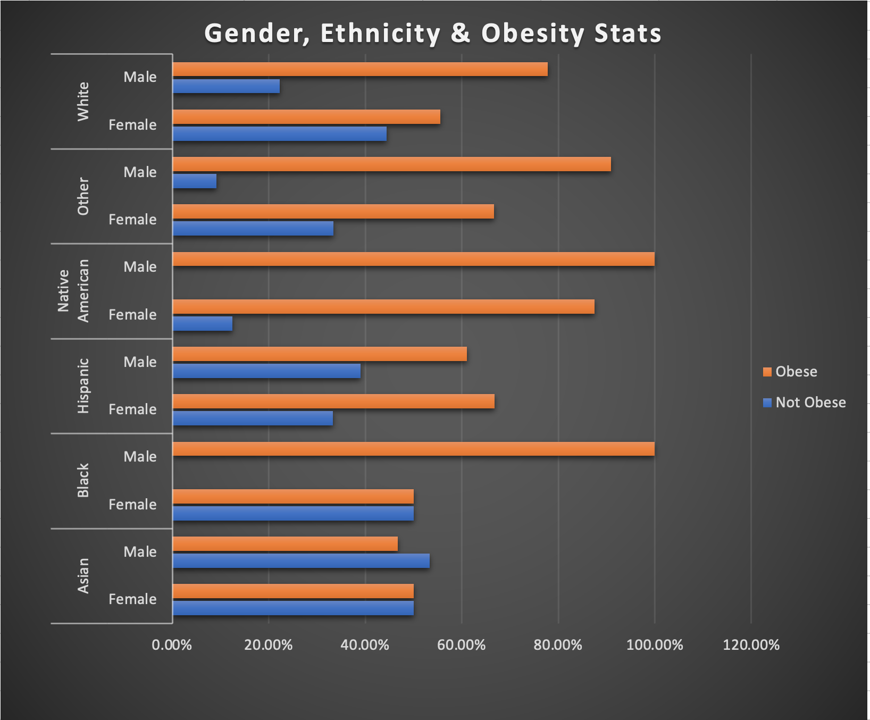
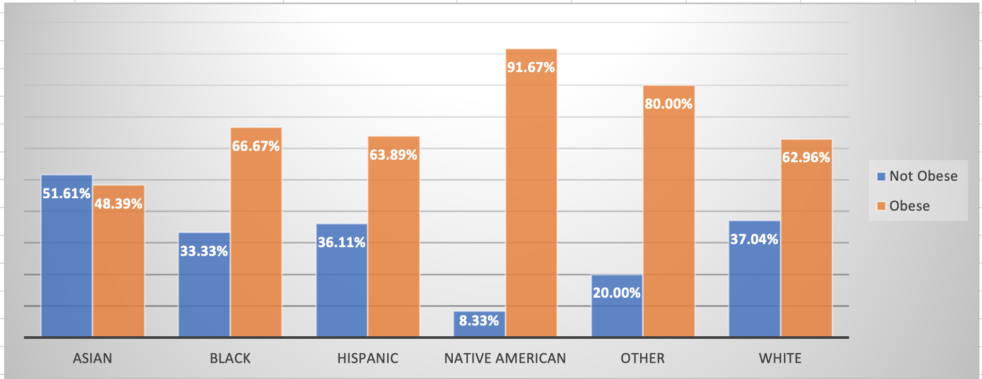
How do obesity rates differ across various demographic groups such as ethnicity, and socioeconomic status? -Otu
Notes:
In the first diagram the percentage goes by Ethnicity and is in regards to the number of ppl that are obese or not. In the second diagram it is the same but the percentages goes by gender.
Key observations
-From our dataset which was gotten from the Rio grande it appears that native americans have the highest obesity percentage, second to hispanics. Asians have the lowest obesity percentage.
According to the CDC Asians do have the lowest percent of obesity at (16.1%) while black adults are the highest at (49.9%)
-Hispanic and asian women are the only genders to surpass their male counterparts in terms of percent obese according to this dataset.
-Asian men are the only male gender to have a higher percent of not obese individuals.

Slide 5
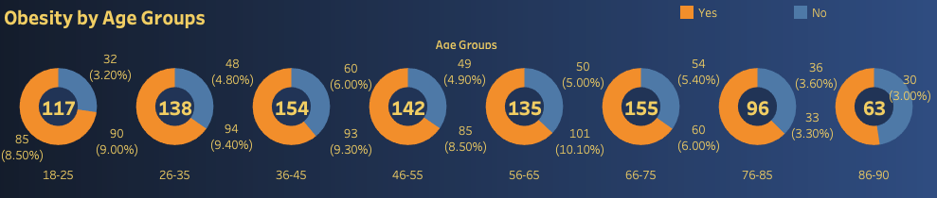
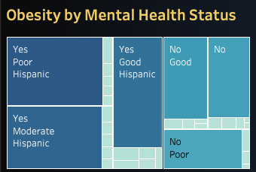
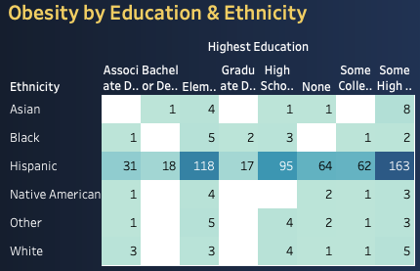
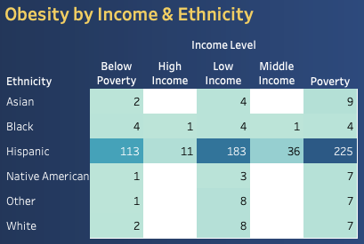
How do obesity rates differ across various demographic groups such as ethnicity, and socioeconomic status? - Juan
Notes:
Donut Chart, Tree Map, Highlight Table

Slide 6
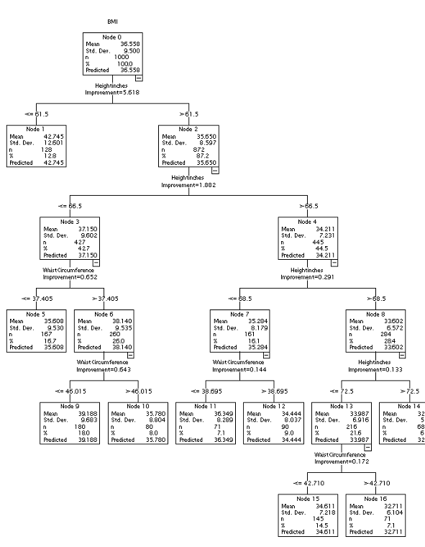


Can we predict BMI using Height and Weight Circumference? - Ashley
Objective
Interpretation
Utilizing decision tree analysis, assessing how height and waist circumference predict BMI, in order to understand the relationship between body measurements and BMI.
Decision points:
The tree categorizes persons into distinct BMI ranges based on their height and weight circumference.
Influential Factors:
Height and waist circumference are shown to be used as splitting criteria, which shows their significance in predicting BMI.

Slide 7
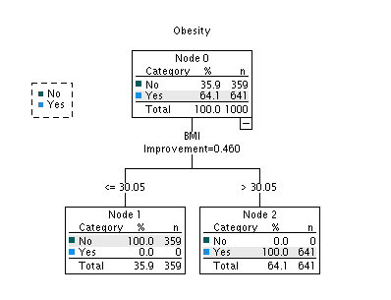
Can we predict obesity with BMI?
Decision Tree Findings:
Critical Threshold
A BMI of 30.05 is a key predictor, separating obese and non-obese individuals.
Split Outcomes
Individuals with BMI less than or equal to 30.05 are predominately not obese, while those with BMI greater than 30.05 are classified as obese.
Model Accuracy & Effectiveness:
Classification Precision
The tree achieved 100% accuracy, aligning with the medical definition of obesity.
Insight
The model confirms BMI > 30 as a clinically accepted threshold for obesity, which demonstrates the potential robustness of BMI as a predictor.

Slide 8
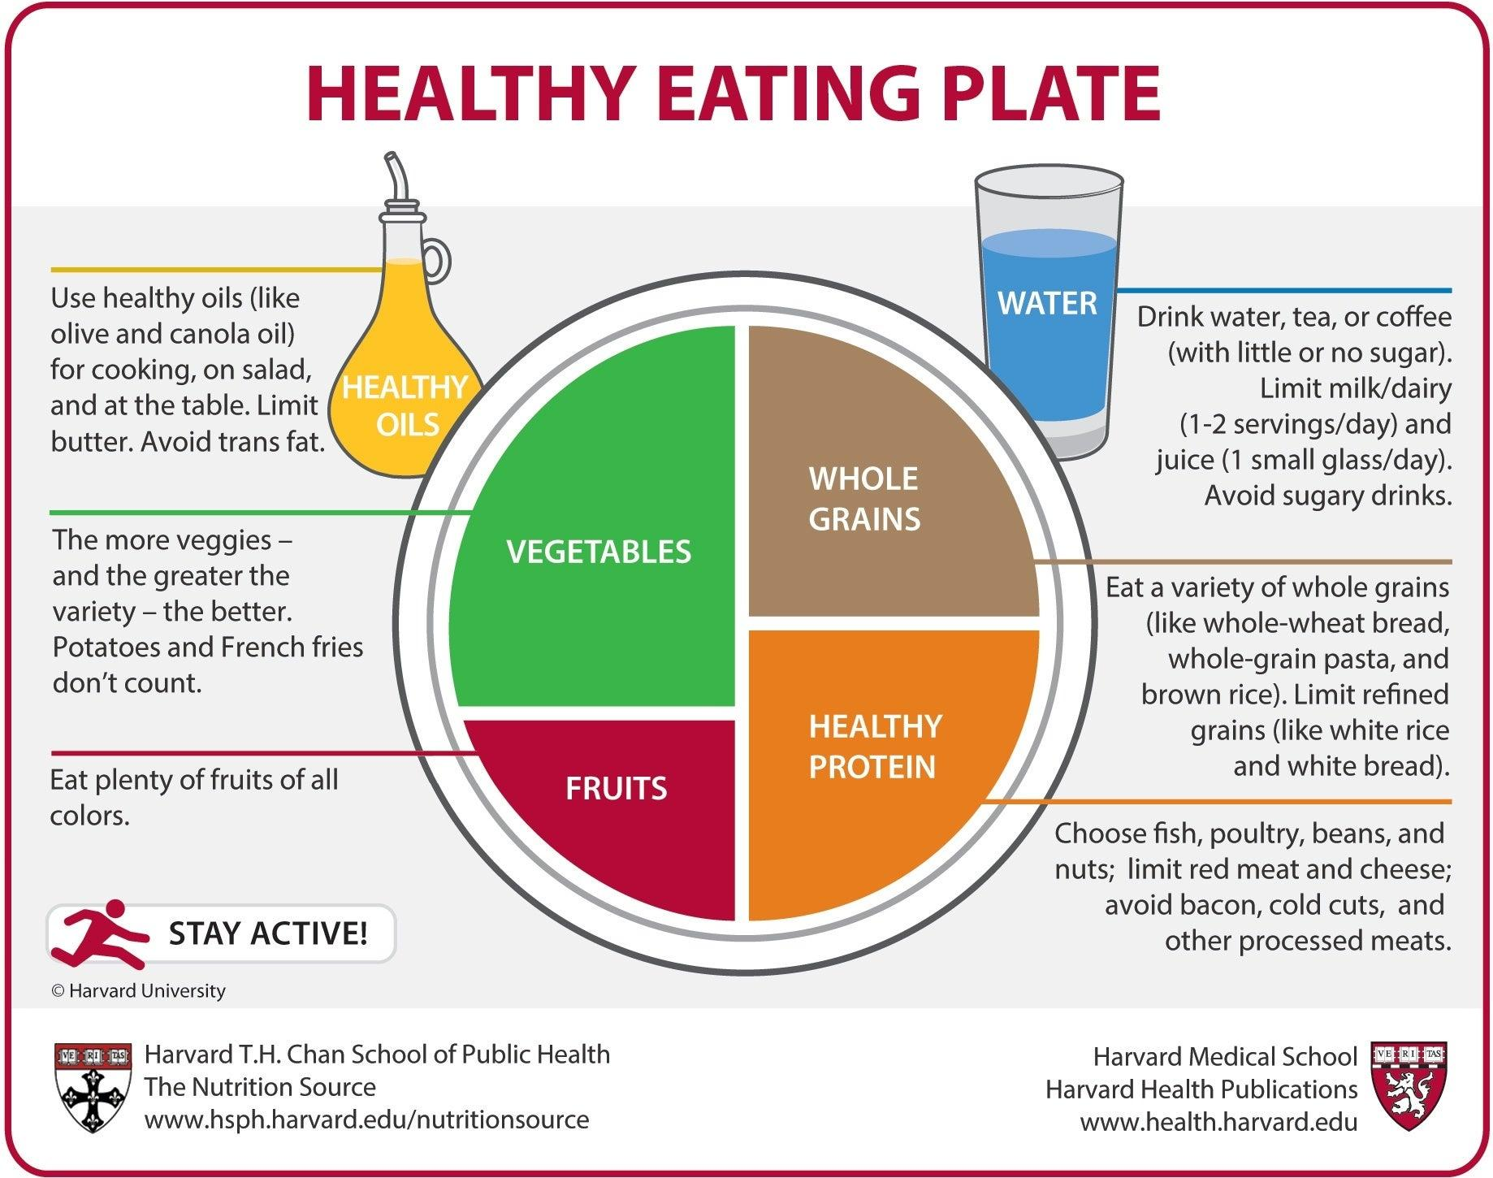

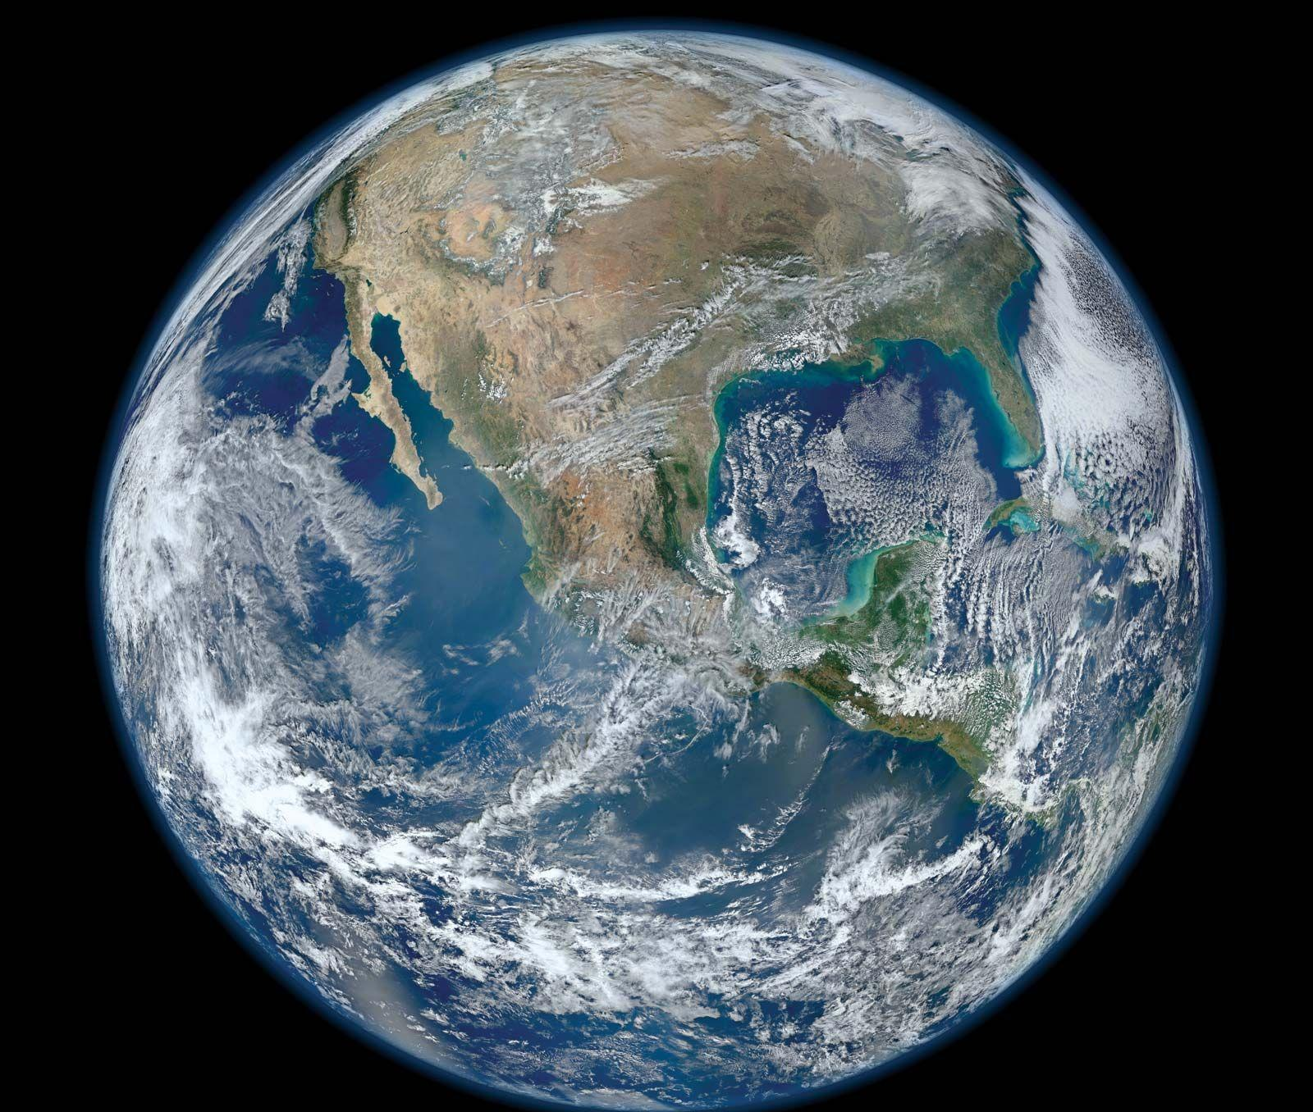
Importance of Obesity Predictors - Mac
Physical predictors?
Stress Level
Mental Health
Behavioral Predictors?
Dietary Patterns
What they eat
Maybe even education on health
Non predictors?
Sex
Ethnicity
Age

Slide 9
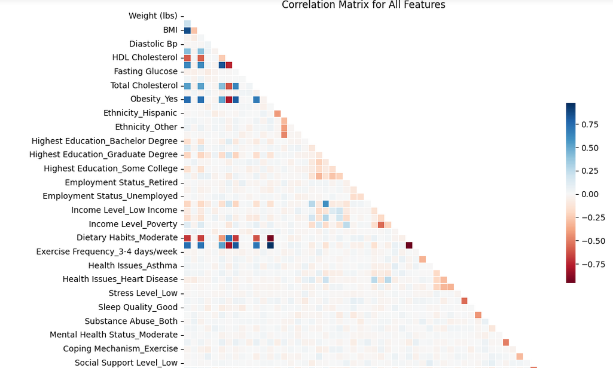
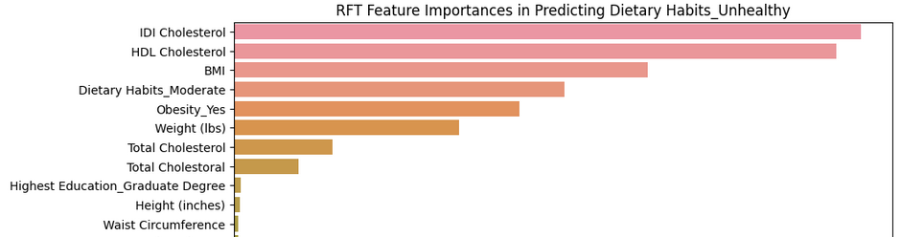
Features, Predictors, and Importance - Mac

Slide 10



Are there any behavioral patterns that correlate with the obesity rates in our dataset? - Jorge
Objective: Examining the correlation between behavioral patterns and obesity rates.
Software used for analysis: Python.
Methodology: Permutation feature importance using K-Nearest Neighbors (KNN) and Random Forest Trees (RFT) models.

Slide 11
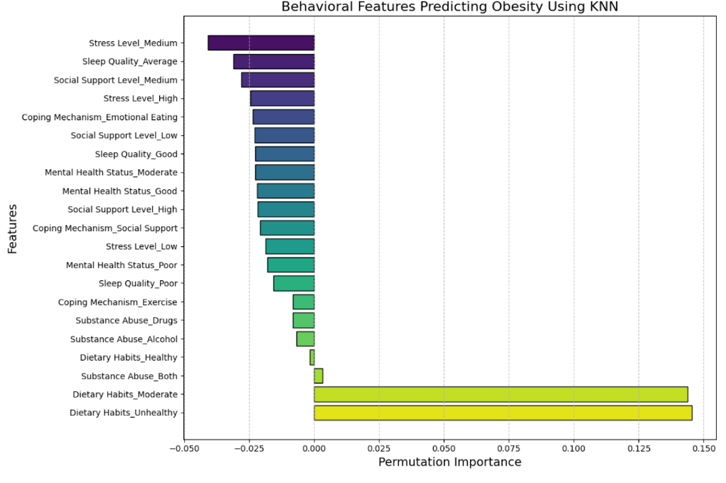
Insights from KNN Model Analysis
Dietary Habits: Identified as the most influential predictor of obesity.
Substance Abuse: Moderately contributes to obesity.
Mental Health and Coping Mechanisms: Emotional eating linked to obesity.
Social Support and Stress Levels: Lower support and higher stress correlate with obesity risk.

Slide 12
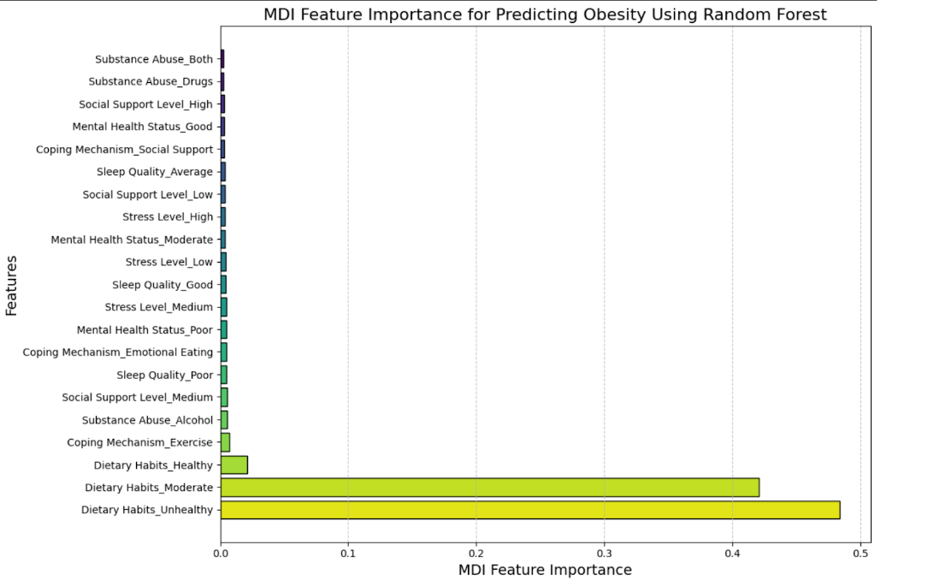
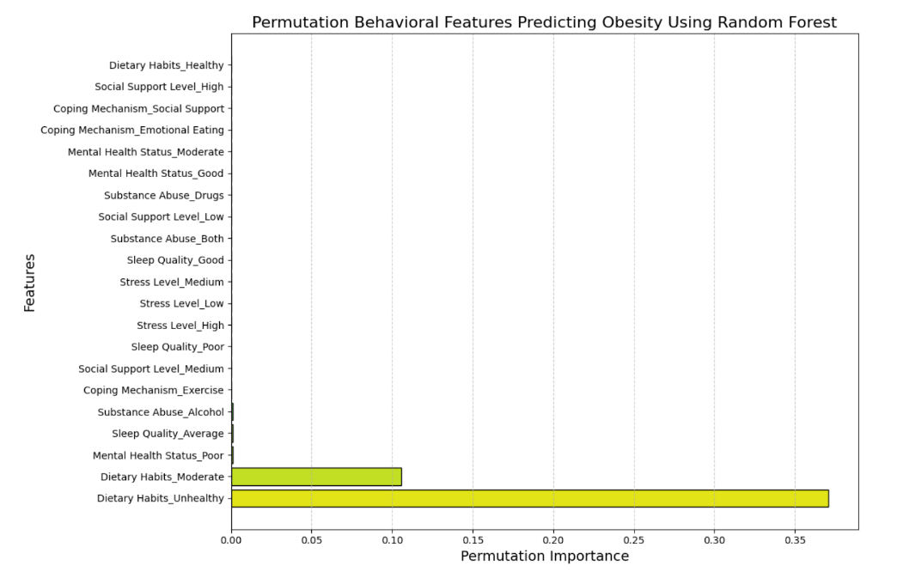
Deeper Analysis with Random Forest Trees
Application of MDI technique alongside permutation importance.
Observations
Consistency in the importance of 'Dietary Habits_Unhealthy'.
Variability in importance of other features like 'Dietary Habits_Healthy', substance abuse, stress levels, and social support.

Slide 13
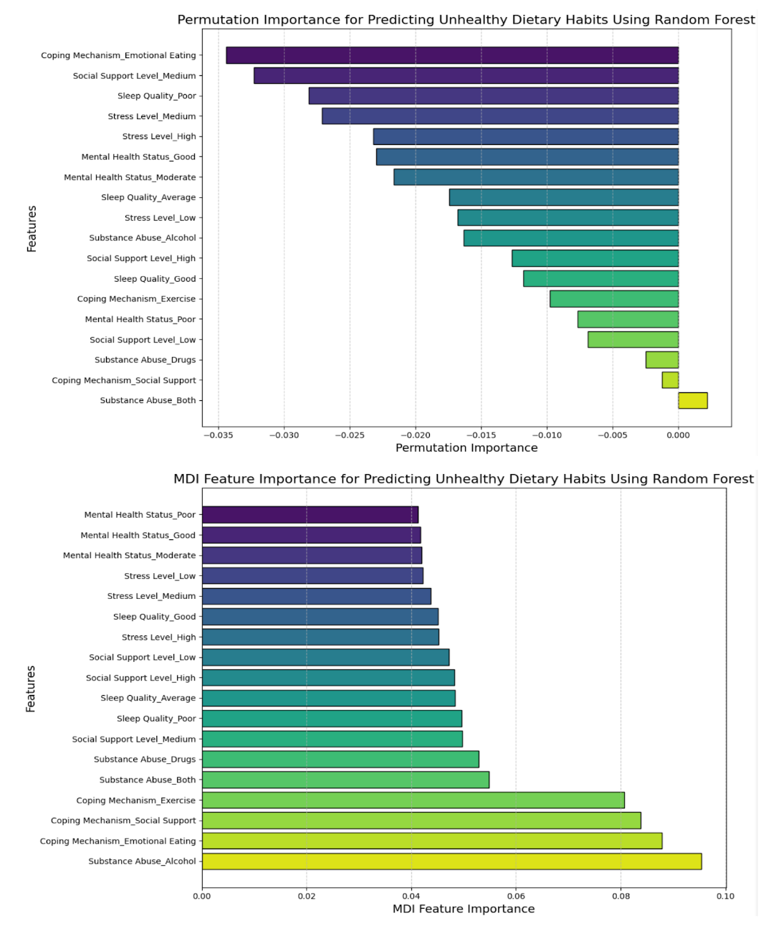
Feature Importance in Predicting Unhealthy Dietary Habits
MDI highlights emotional eating, alcohol abuse, and poor sleep quality as key predictors.
Differences in scores between methods, indicating sensitivity to feature interactions and data noise.
Variance between methods underscores the need for multiple analytical approaches for a comprehensive understanding.

Slide 14

Observations and Interpretations
Significant role of unhealthy dietary habits in obesity.
Correlation of sleep quality, stress levels, and substance abuse with obesity.
Importance of behavioral modification in influencing obesity outcomes.

Slide 15
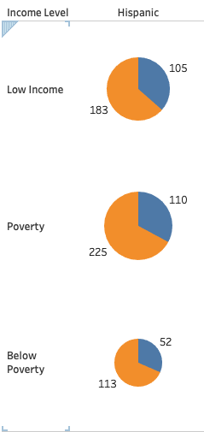
If someone is Hispanic and has a low poverty level, how often will they be obese? - Juan
Association Rule Analysis: Hispanic Population
Identified strong associations within the Hispanic population across different income levels via usage of the Apriori Algorithm.
Insights into Hispanic Obesity Patterns
Patterns suggests that low-income – below poverty Hispanics are more likely to be obese.
Focus on Low Income Hispanics
Addressing obesity concerns may require targeted interventions for Hispanic individuals who are at or below the low-income level.
Notes:
Association Rules for Hispanic with Below Poverty level: antecedents consequents support confidence lift 9 (Hispanic, Below Poverty) (Yes) 0.113 0.684848 1.068406
Association Rules for Hispanic with Poverty level: antecedents consequents support confidence lift 17 (Hispanic, Poverty) (Yes) 0.225 0.671642 1.047803
Association Rules for Hispanic with Low Income level: antecedents consequents support confidence lift 13 (Hispanic, Low Income) (Yes) 0.183 0.635417 0.99129

Slide 16
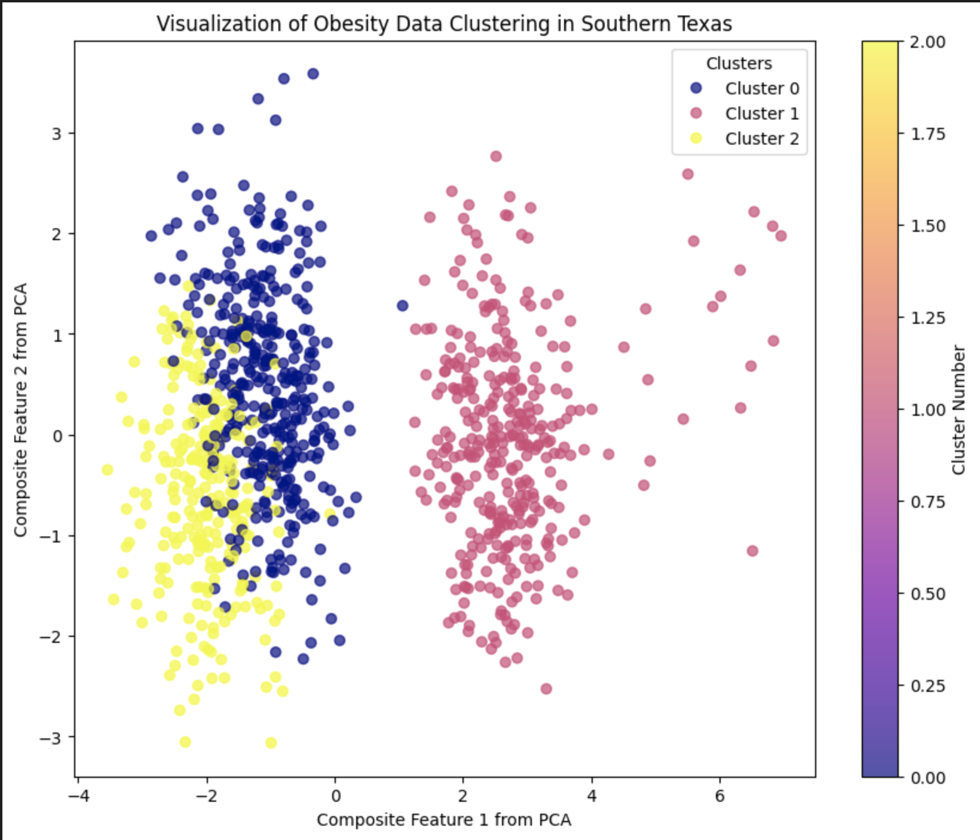
Can we segment the population at risk of being obese? -Otu
Cluster 0: Middle-aged, Obese
Age: ~54 years
Weight: ~239 lbs.
Height: ~5 ft 8 in
BMI: ~36 (Obese)
Blood Pressure: 124/79 mmHg
Cholesterol: High Total (210 mg/dL), Low HDL
Waist: ~39 inches
Cluster 1: Middle-aged, Overweight
Age: ~54 years
Weight: ~170 lbs.
Height: ~5 ft 6 in
BMI: ~27 (Overweight)
Blood Pressure: 125/80 mmHg
Cholesterol: Better Profile (178 mg/dL), High HDL
Waist: ~40 inches
Cluster 2: Younger, Severely Obese
Age: ~49 years
Weight: ~281 lbs.
Height: ~5 ft 3 in
BMI: ~49 (Severe Obesity)
Blood Pressure: 126/81 mmHg
Cholesterol: High Total (211 mg/dL), Low HDL
Waist: ~41 inches
Notes:
In my cluster analysis using the KMeans algorithm, I determined the clusters based on the features included in my dataset and the preprocessing steps I applied. Here's a breakdown of how I determined the clusters and what variables I used:
1. Data Preprocessing:
- I began by dropping irrelevant columns like 'Patient ID', 'ZIP Code', 'Date of Birth', etc. This allowed me to focus on variables more likely to influence obesity risks.
- I identified categorical features such as 'Sex', 'Ethnicity', 'Obesity', etc., and numerical features like 'Age', 'Weight', 'BMI', etc.
- For categorical features, I used one-hot encoding, converting them into binary (0/1) columns. This was necessary because the KMeans algorithm requires numerical input.
- The numerical features were scaled using StandardScaler, standardizing the range of these features so that each one contributes equally to the distance calculations in the KMeans algorithm.
2. Feature Selection:
- In the KMeans algorithm within my pipeline, both the one-hot encoded categorical features and the scaled numerical features were used.
- This means the clustering was based on a mix of lifestyle, demographic, and health-related variables, providing a comprehensive perspective on factors that might influence obesity risks.
3. Cluster Determination:
- The KMeans algorithm partitions the data into 'k' clusters, where 'k' was set to 3 in my case.
- It involves assigning each data point to the nearest cluster centroid and recalculating the centroids based on current cluster memberships. This process repeats until the cluster assignments stabilize.
- The 'distance' used here is typically the Euclidean distance, calculated in the multidimensional space of the features.
4. Cluster Interpretation:
- After clustering, I added the cluster labels back to the original DataFrame. This allowed me to interpret each cluster by examining the common characteristics of the members within each cluster.
- By calculating the mean of each numeric feature for each cluster, I could interpret the average profile of each cluster. For instance, one cluster might represent younger individuals with a lower BMI, while another might include older individuals with higher BMI and specific health issues.
In conclusion, my clusters were determined using a variety of lifestyle, demographic, and health metrics, all processed and scaled appropriately for the KMeans algorithm. The final clusters represent groupings of individuals with similar characteristics across these variables, offering insights into different segments of the population in relation to obesity risks.

Slide 17
Summary of Key Findings
In terms of identifying obesity, our study confirms that BMI is a critical and almost direct indicator. An unhealthy height to waist circumference ratio will directly reveal an individual's obesity status - determining whether an individual is obese or not.
Dietary habits, poor sleep quality, alcohol or general substance abuse, high stress levels, poor coping mechanisms, poor mental health, poor social support, ethnicity - all, to a great and concerning extent - with some more impactful than others, move an individual closer to obesity and, consequently, give rise to the high prevalence of obesity in the RGV.
Socioeconomic factors like income level, education level, and ethnicity, notably within the Hispanic community, have been identified as significant correlates to obesity through association rule mining and other visualization techniques.
Cluster analysis further segmented the population, pinpointing specific risk groups with a variety of lifestyle factors.

